Slide 1
Weather Classification Dataset for Computer Vision
Muhammad Faizan
SP20-BCS-101

Slide 2
AGENDA
Introduction
Defining the Weather Classes
Collecting Weather Data
Data Annotation
Data Splitting
Summary

Slide 3
INTRODUCTION
we will introduce the concept of weather classification and its significance in computer vision applications. We will discuss how accurately categorizing weather conditions such as sunny, rainy, cloudy, and shine can enhance various computer vision tasks, including autonomous driving, scene understanding, and object detection. Furthermore, we will explore the challenges associated with weather classification and emphasize the importance of reliable and well-curated datasets in addressing these challenges.

Slide 4
Defining the Weather Classes
Cloudy
Rain
Shine
Sunrise

Slide 5

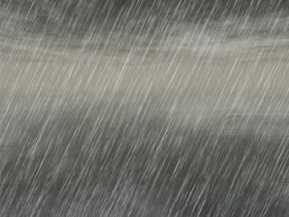


Weather Classes (Images)
Cloudy
Rainy
Shine
Sunrise

Slide 6
Collecting Weather Data
The weather images have been collected very carefully from Google.
Image Search and Filtering: Using relevant weather-related keywords and apply appropriate usage rights filters to find suitable images.
Data Diversity: Collecting images from different geographical locations to capture weather variations.
Data Cleaning: Remove low-quality and irrelevant images to ensure dataset integrity.

Slide 7
Data Annotation
Accurate and consistent labeling of the weather classes is essential for creating a reliable weather classification dataset
Image Labeling Approach:
Class Folder Structure: Organize the weather images into separate folders based on their respective classes (sunrise, rainy, cloudy, shine).
Python Script: Developed a Python script that iterates through each image in the class folders and assigns the appropriate class label and numbering to the image file.
Class Labeling Convention: Used consistent and descriptive class names (e.g., “rainy1.jpg," “shine2.jpg") to represent each labeled image.

Slide 8
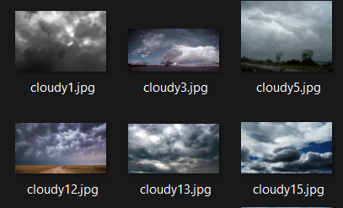
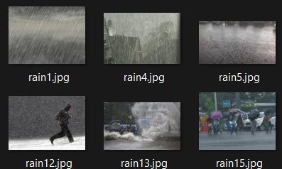
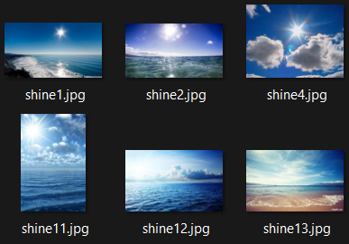
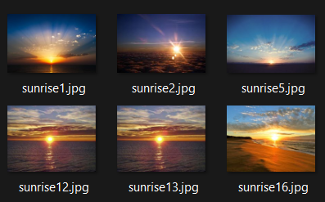
Annotated Weather Images (Classes)
Cloudy
Rainy
Shine
Sunrise

Slide 9
Dataset splitting
The weather images have been collected very carefully from Google.
Train-Test Split Ratio: Divided the weather classification dataset into two subsets: a training set and a testing set.
80% Train Split: Allocated 80% of the dataset to the training set, ensuring a sufficiently large sample for model training.
20% Test Split: Reserved 20% of the dataset for the testing set to evaluate the model's performance on unseen data.

Slide 10
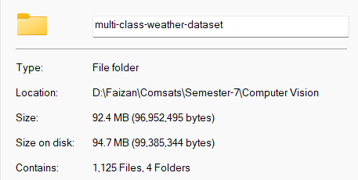
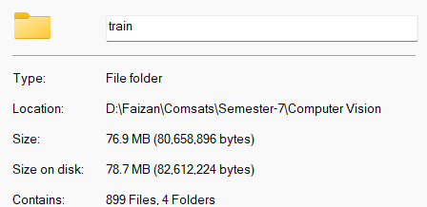
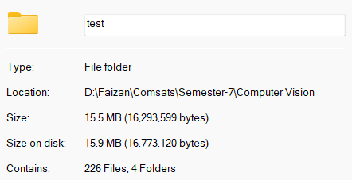
Train – Test Split (Dataset)
Dataset
Train Set
Test Set

Slide 11
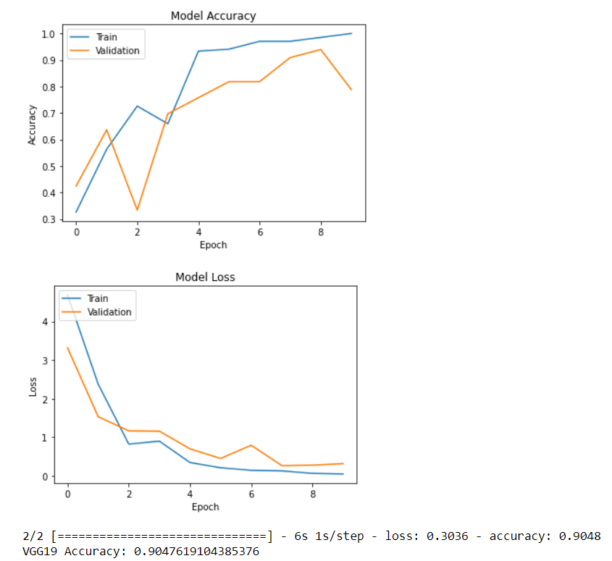
VGG19

Slide 12
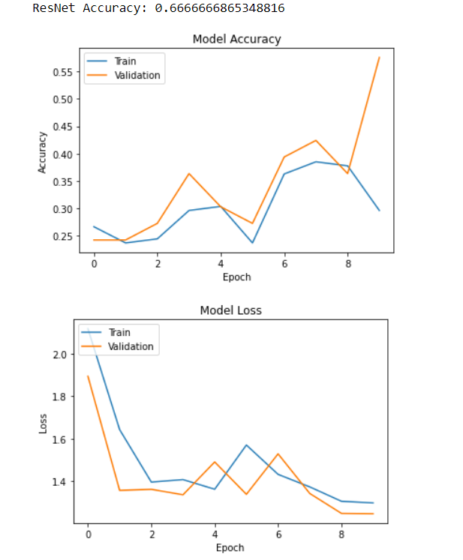
rESnET

Slide 13
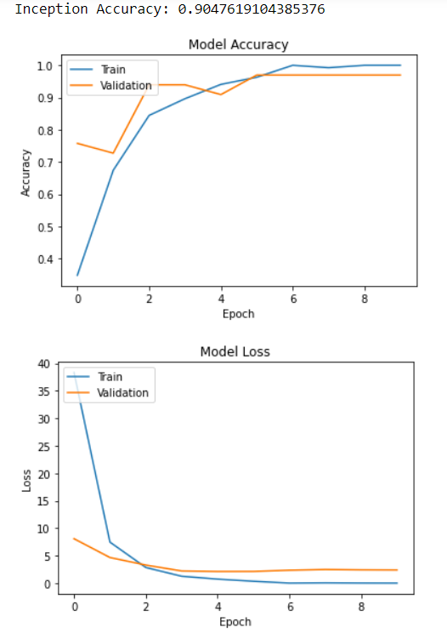
iNception

Slide 14
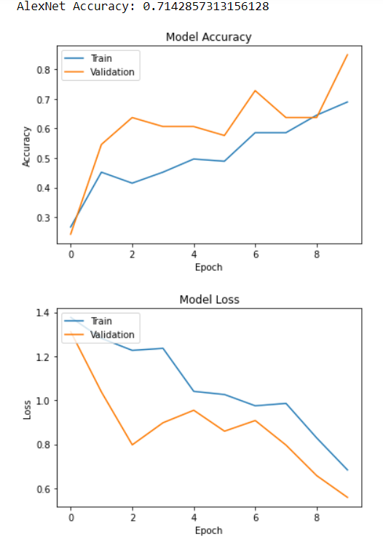
Alexnet

Slide 15
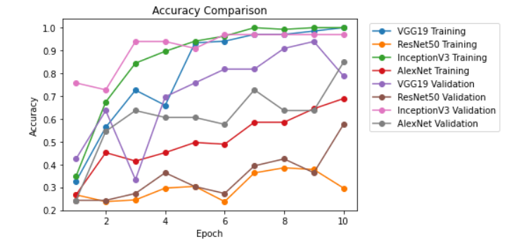
Accuracy comparison

Slide 16
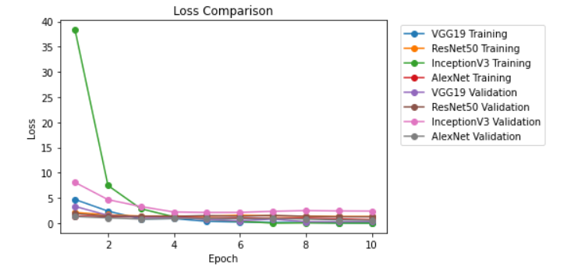
Loss comparison

Slide 17
Code
For codes we have attached notebook file

Slide 18
SUMMARY
Defining weather classes provides a foundation for categorizing weather conditions accurately. Collecting diverse weather data from multiple sources ensures dataset robustness. Data annotation ensures accurate labeling, while the train-test split allows for model training and evaluation. These steps collectively contribute to the creation of a reliable weather classification dataset for computer vision applications.

Slide 19
THANK YOU
Muhammad Faizan
SP20-BCS-101

